Slide 1
Cell Coverage for Signal and Traffic
Cell coverage can be based on signal coverage or on traffic coverage
The task is to cover the whole area with a minimum number of cell sites.
Because 100 percent cell coverage of an area is not possible
The cell sites must be engineered so that the holes are located in the no-traffic locations.

Slide 2
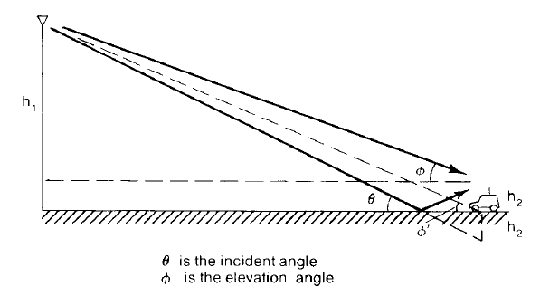
Ground Incident Angle and Ground Elevation Angle

Slide 3
Example 1
In a mobile radio environment, the average cell-site antenna height is about 50 m, the mobile antenna height is about 3 m, and the communication path length is 5 km.

Slide 4
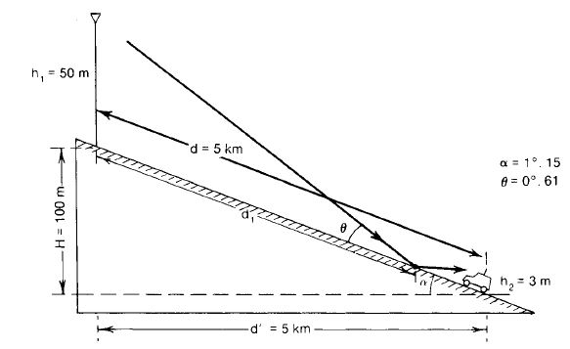
Ground Reflection Angle and Reflection Point

Slide 5
Example 2

Slide 6
OBTAINING THE MOBILE POINT-TO-POINT MODEL (LEE MODEL)
Generate a standard condition
Obtain an area-to-area prediction model
Obtain a mobile point-to-point model using
the area-to-area model as a base

Slide 7
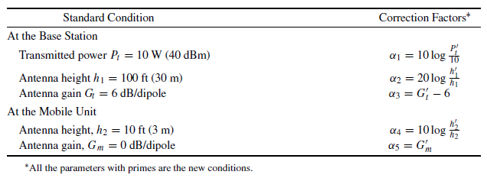
Generating the Standard Condition

Slide 8
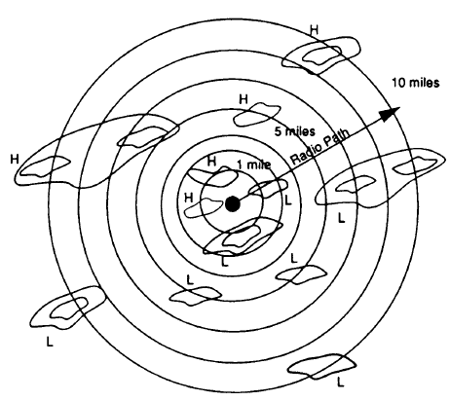
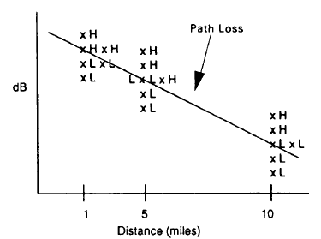
Effect of the Human-Made Structures
Propagation path loss curves for human-made structures.
(a) For selecting measurement areas
(b) path loss phenomenon.

Slide 9
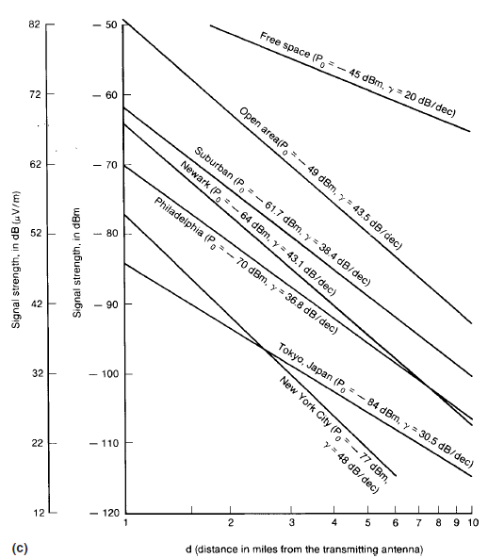
Effect of the Human-Made Structures
(c) Propagation path loss in different cities.

Slide 10
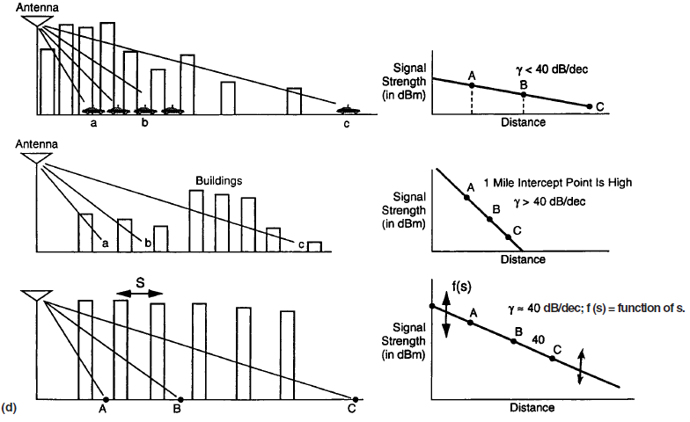
The Phase Difference between a Direct Path and a Ground-Reflected Path
(d) Explanation of the path-loss phenomenon.

Slide 11
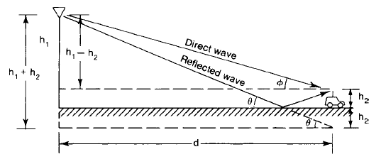
A Simple Model

Slide 12
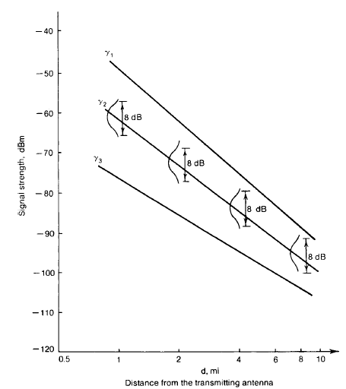
Constant Standard Deviation along a Path-Loss Curve
An 8-dB local mean spread.

Slide 13
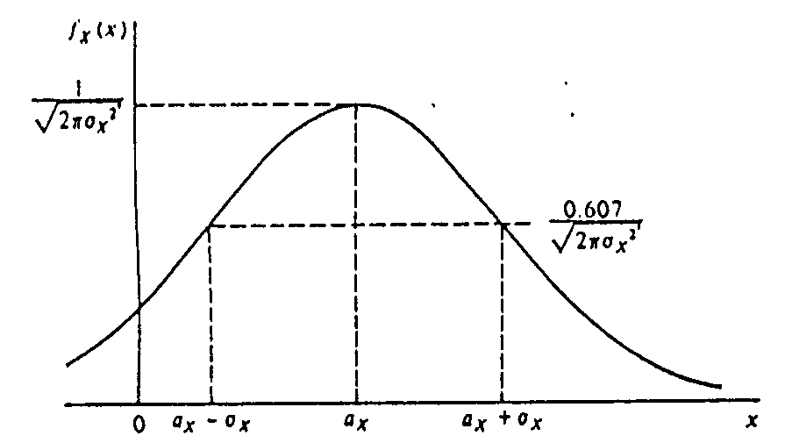
Gaussian

Slide 14
Straight Line path loss slope with confidence
The received power is

Slide 15
Confidence level

Slide 16
The different Confidence Levels

Slide 17
Example
From the path-loss curve, we read the expected signal level as −100 dBm at 16 km (10 mi). If the standard deviation σ = 8 dB, what level would the signal equal or exceed for a 20 percent confidence level?

Slide 18
Determination of Confidence Interval
If we know the standard deviation, then we can estimate how often the local mean (average power of the signal) falls within given limits (confidence interval).
The confidence intervals are defined as

Slide 19
Determination of Confidence Interval
The standard deviation can be found from the table

Slide 20
A General Formula for Mobile Radio Propagation

Slide 21
A General Formula for Mobile Radio Propagation
Sub-urban area
The 1-mi intercept level in a sub-urban area is −61.7 dBm under the standard conditions
From the theoretical prediction model the received power Pr at the suburban area is

Slide 22
A General Formula for Mobile Radio Propagation
The above equation is simplified as
To change the above equation to a general formula by using Pr at 10 mi as a reference which is −100 dBm
Also the 40 dB/oct slope used is generous

Slide 23
A General Formula for Mobile Radio Propagation
The most general formula is expressed as follows

Slide 24
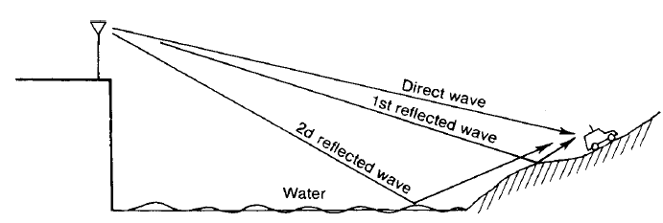
PROPAGATION OVER WATER OR FLAT OPEN AREA
A model for propagation over water.

Slide 25
Between Fixed Stations

Slide 26
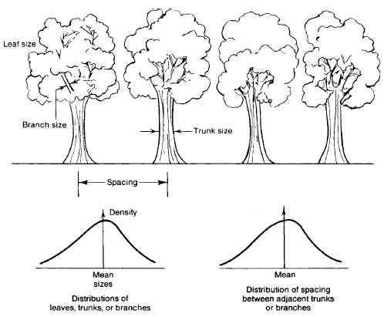
A characteristic of Foliage Environment

Slide 27
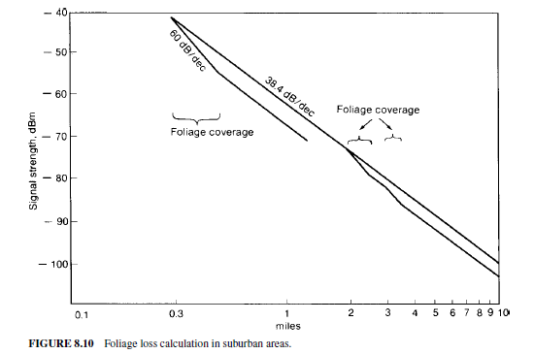
Foliage Loss

Slide 28
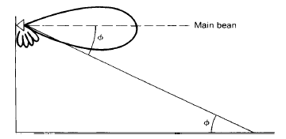
PROPAGATION IN NEAR-IN DISTANCE
Elevation angle of the shadow of the antenna pattern.

Slide 29
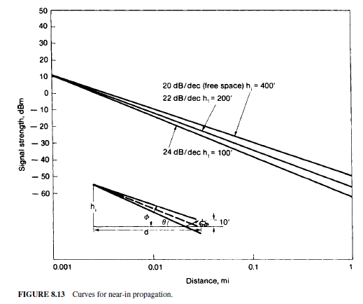
Curves for Near-in Propagation

Slide 30
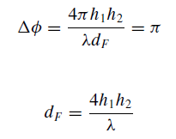
Calculation of Near-Field Propagation
The range d_{F}of near field

Slide 31
LONG-DISTANCE PROPAGATION
Noise-limited system
Interference-limited system
Tropospheric refraction
Tropospheric reflection.
Moistness
Trapping, or duct propagation
Elevated ducts are due to large air masses (elevations of 1000 to 5000 ft , thickness from a few feet to a thousand feet.)
Surface ducts appear over the sea and are about 1.5 m (5 ft) thick. And are produced by the cooling air of the earth.

Slide 32
LEE MODEL IN NON-OBSTRUCTIVE CONDITION

Slide 33
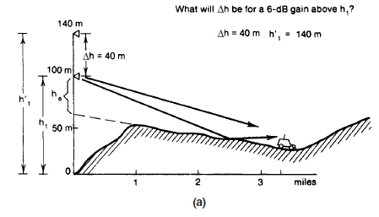
OBTAIN PATH LOSS FROM A POINT-TO-POINT PREDICTION MODEL: A GENERAL APPROACH
Finding the Antenna-Height Gain

Slide 34
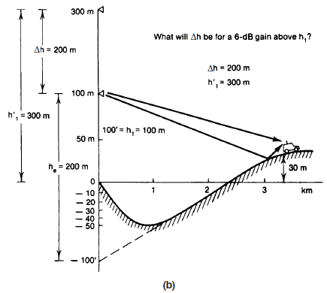
Finding the Antenna-Height Gain

Slide 35
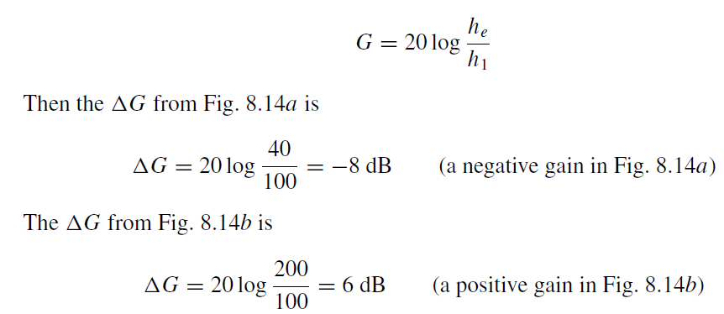
Antenna Height Gain

Slide 36
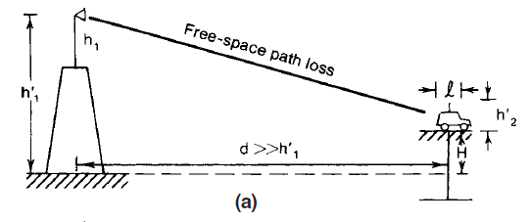
Another Physical Explanation of Effective Antenna Height

Slide 37
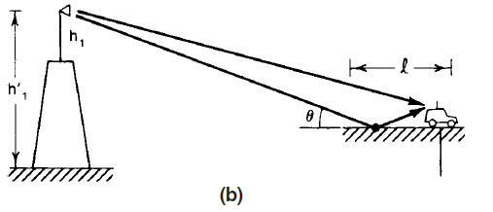
Another Physical Explanation of Effective Antenna Height

Slide 38
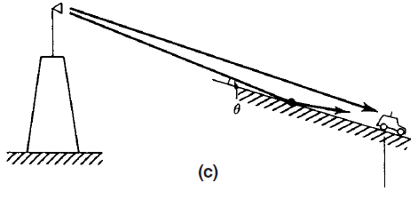
Another Physical Explanation of Effective Antenna Height

Slide 39
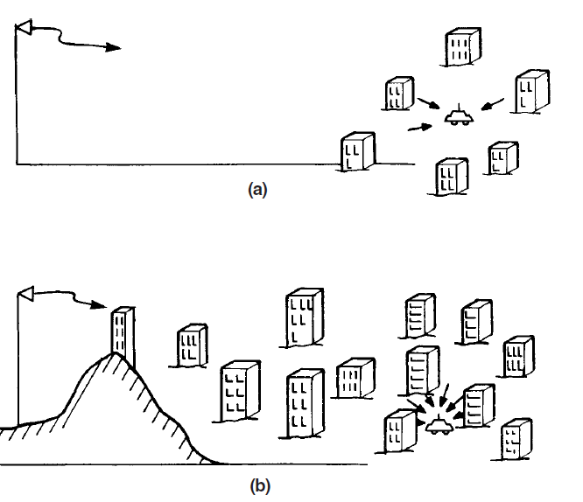
Man-made environment
Sparse man-made structures.
Dense man-made structures.

Slide 40
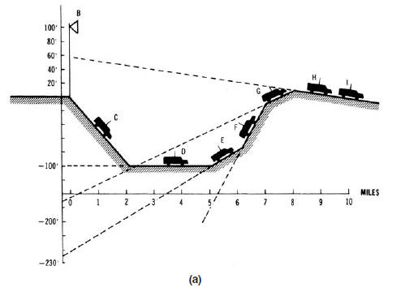
Illustration of the terrain effect on the effective antenna gain at each position.
(a) Hilly terrain contour.

Slide 41
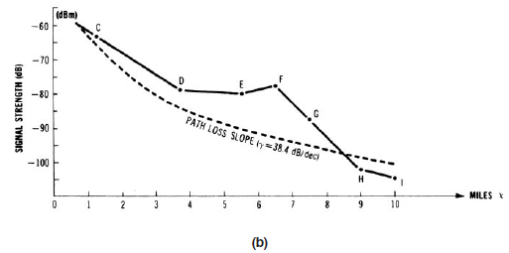
Illustration of the terrain effect on the effective antenna gain at each position
(b) Point-to-point prediction

Slide 42
In Obstructive Condition

Slide 43
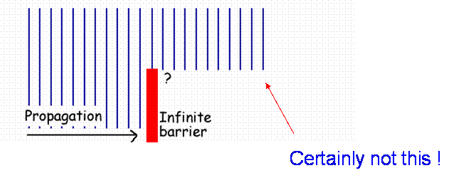
Obstructive condition

Slide 44
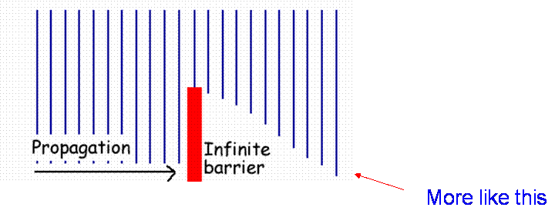
Obstructive condition

Slide 45
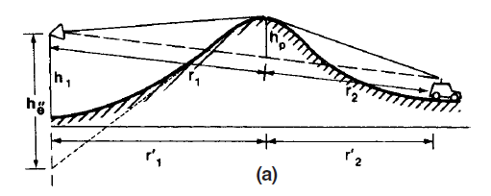
Diffraction loss due to obstructive conditions
(a) Single knife-edge

Slide 46
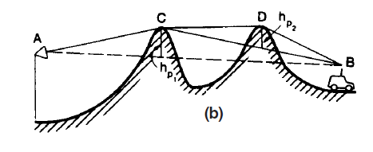
Diffraction loss due to obstructive conditions
(b) double knife-edges

Slide 47
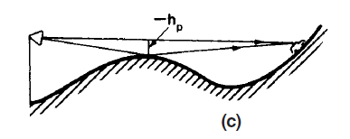
Diffraction loss due to obstructive conditions
(c) nonclear path.

Slide 48
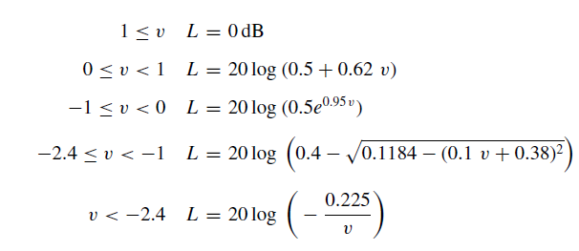
Measurement of Diffraction Loss or Shadow Loss

Slide 49
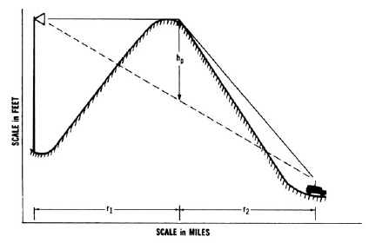
Shadow loss Prediction

Slide 50
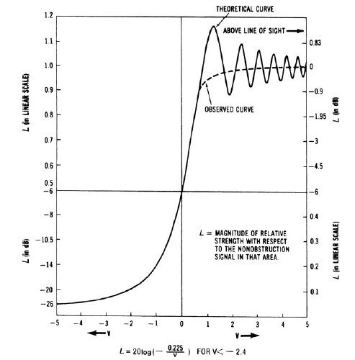
Shadow Loss Prediction

Slide 51
General Formula of Lee Model
1. Direct-wave case.
The effective antenna height is a major factor which varies with the location of the mobile unit while it travels.
2. Shadow case.
No effective antenna height exists. The loss is totally due to the knife-edge diffraction loss.
3. Over-the-water condition.
The free space path-loss is applied.

Slide 52
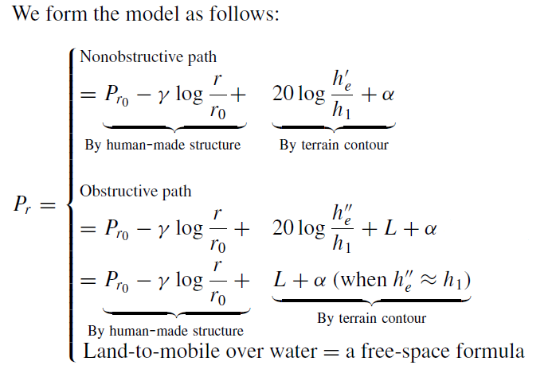
General Formula of Lee Model

Slide 53
Merits of Lee Model
The point-to-point model is very useful for designing a mobile cellular system with a radius for each cell of 10 mi or less.
This point-to-point prediction can be used to provide overall coverage of all cell sites and to avoid cochannel interference.
The occurrence of handoff in the cellular system can be predicted more accurately.
The point-to-point prediction model is a basic tool that is used to generate
a signal coverage map
an interference area map
a handoff occurrence map
or an optimum system design configuration

Slide 54
CELL-SITE ANTENNA HEIGHTS AND SIGNAL COVERAGE CELLS

Slide 55
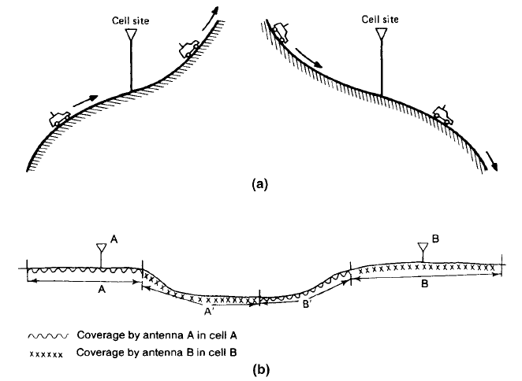
Visualization of effective antenna height & Coverage Cells
Different coverage concept.
Signal coverage due to effective antenna heights.
Signal coverage served by two cell sites.

