Slide 1
HANDOFFS AND DROPPED CALLS
Unit - 7

Slide 2
Why Handoffs?
Handoff – voice channel
Paging channels – Common Control channels
value of implementing handoffs
size of the cell
people talk longer

Slide 3
Handoff is needed in two situations

Slide 4
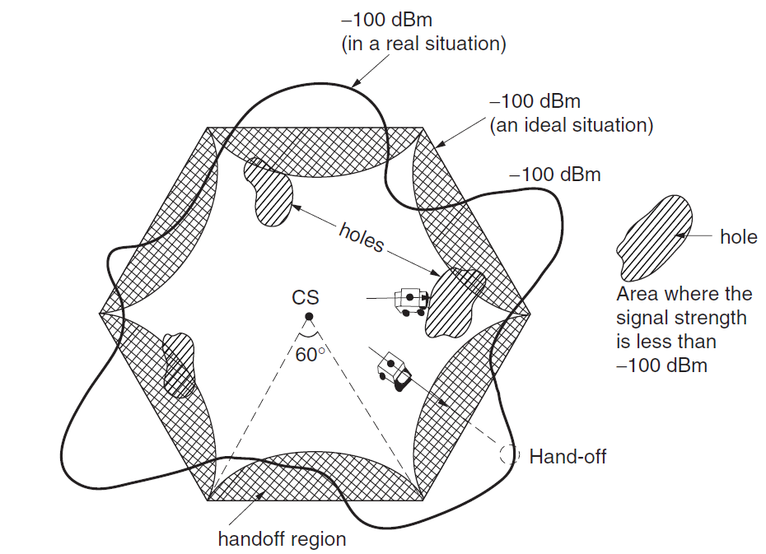

Slide 5
Signal Coverage Cells

Slide 6
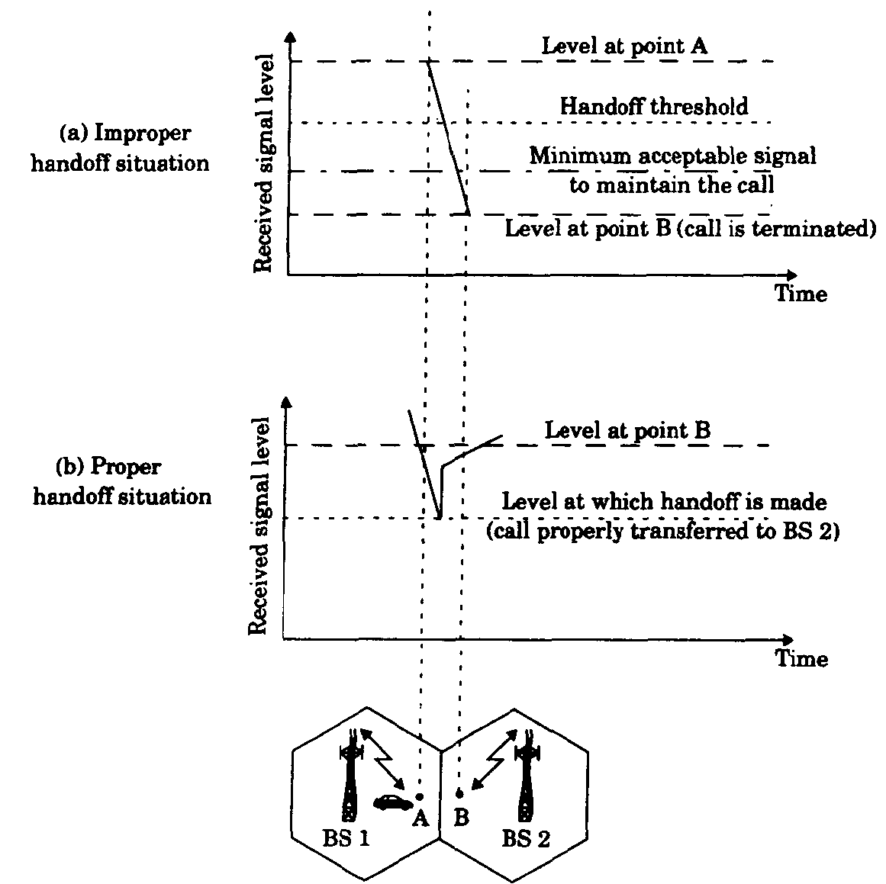

Slide 7
Two Decision-Making Parameters of Handoff

Slide 8
Two Decision-Making Parameters of Handoff
Based on
signal strength
carrier-to-interference ratio

Slide 9
Type -1
the signal-strength threshold level for handoff is
−100 dBm – noise-limited systems
−95 dBm – interference-limited systems

Slide 10
Type - 2
C/I at the cell boundary for handoff should be at a level, 18 dB

Slide 11
Type - 1
Location receiver at each cell site
Received signal strength (RSS)
RSS = C + I
Two situations may occur
I more
I Less
Not accurate

Slide 12
Type - 2
Carrier to Interference Ratio
Two situations occur
C Less
I more

Slide 13
Determining the Probability of Requirement for Handoffs

Slide 14
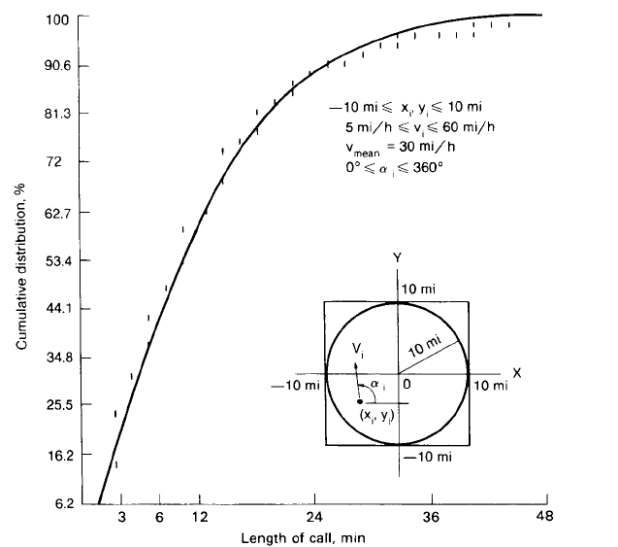
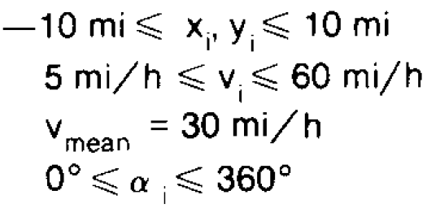
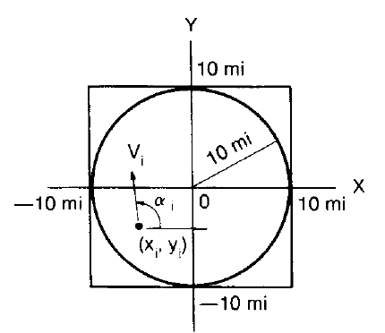

Slide 15
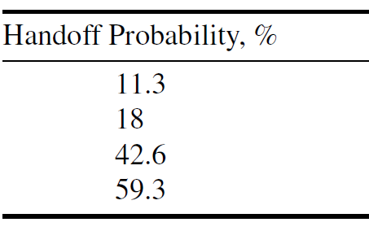
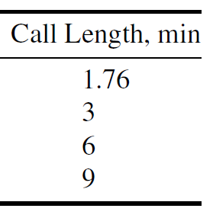

Slide 18
Handoff
Soft Handoff – Make Before Break
Hard Handoff – Break Before Make

Slide 19
Number of Hard Handoffs Per Call
0.2 handoff per call in a 16- to 24-km cell
1–2 handoffs per call in a 3.2- to 8-km cell
3–4 handoffs per call in a 1.6- to 3.2-km cell

Slide 20
INITIATION OF A HANDOFF

Slide 21
INITIATION OF HANDOFF
Signal strength - reverse voice channel
Threshold level - minimum required voice quality
Cell site – MTSO
Unnecessary Handoff
Failure Handoff

Slide 22
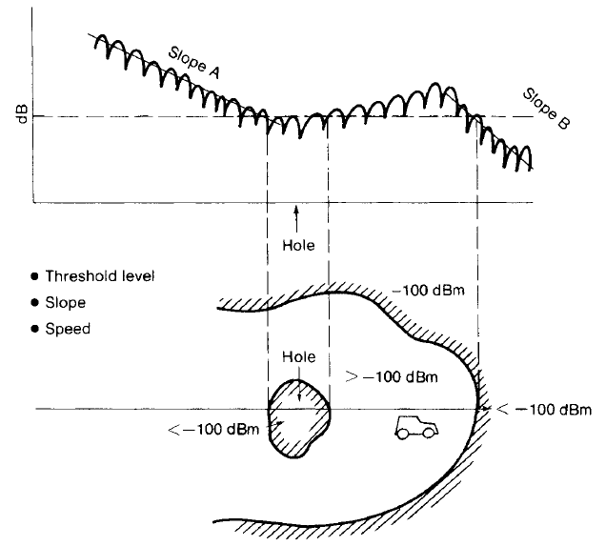

Slide 23
The velocity of vehicle V and the pathloss slope γ , can be used to determine the value of Δ dynamically

Slide 24
Two circumstances where handoffs are necessary but cannot be made

Slide 25
Situations
When the mobile unit is located at a signal-strength hole within a cell but not at the boundary
When the mobile unit approaches a cell boundary but no channels in the new cell are available.

Slide 26
DELAYING A HANDOFF
A Two-Level Handoff Algorithm
Advantage of Delayed Handoffs
Switching processor
Interference

Slide 27
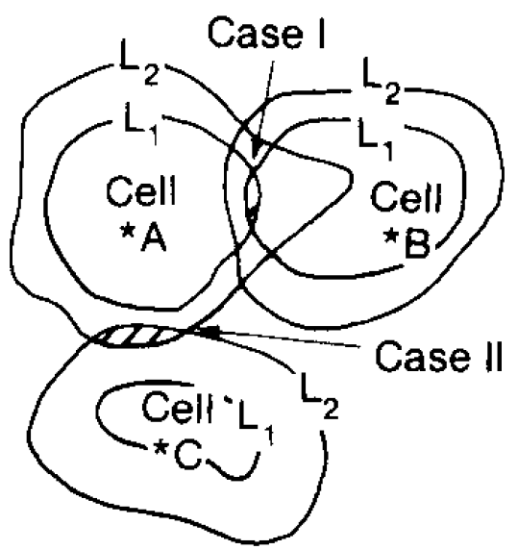

Slide 28
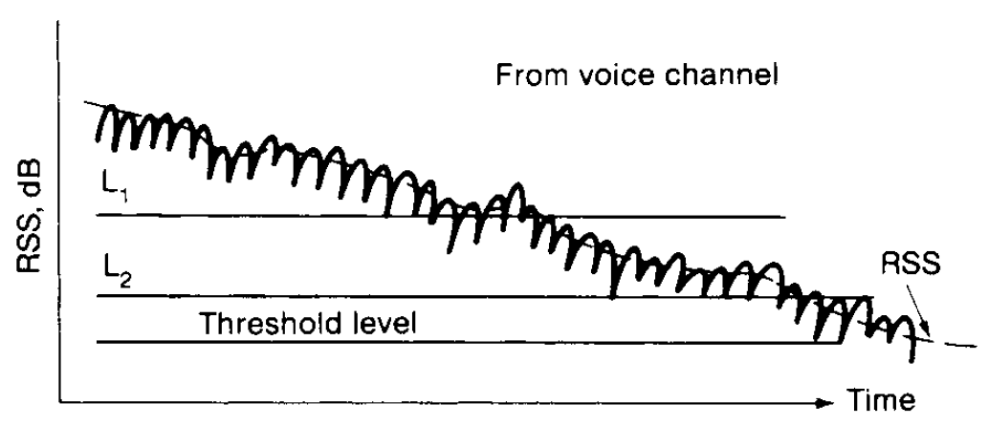

Slide 29
FORCED HANDOFFS
A forced handoff is defined as a handoff that would normally occur but is prevented from happening, or a handoff that should not occur but is forced to happen.

Slide 30
Handoff
Controlling a Handoff
By cell site – threshold level - variation
By MSC
Creating a Handof
MSC ordering Cellsite – threshold level increase

Slide 31
QUEUING OF HANDOFFS
Queuing of handoffs is more effective than two-threshold-level handoffs
1/μ - average calling time in seconds, including new calls and handoff calls in each cell
λ1 - arrival rate (λ1 calls per second) for originating calls
Λ2 - arrival rate (λ2 handoff calls per second) for handoff calls
M1- size of queue for originating calls
M2 -size of queue for handoff calls
N- number of voice channels
a =(λ1 + λ2)/μ
b1 =λ1/μ
b2= λ2/μ

Slide 32
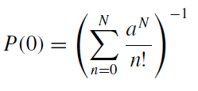
Case – 1
No queuing on either the originating calls or the handoff calls
The blocking for either an originating call or a handoff call is

Slide 33
Case-2
Queuing the originating calls but not the handoff calls
The blocking probability for originating calls is

Slide 34
Case -2
The blocking probability for handoff calls is

Slide 35
Case-3
Queuing the handoff calls but not the originating calls

Slide 36
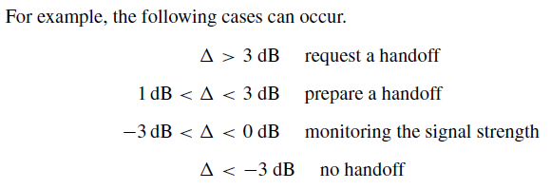
POWER-DIFFERENCE HANDOFFS
power difference (∆)

