Slide 1
GLOBAL SYSTEM FOR MOBILE (GSM)
The Mobile Station
Base Station Subsystem
Network and Switching Subsystem
Operation Subsystem

Slide 2
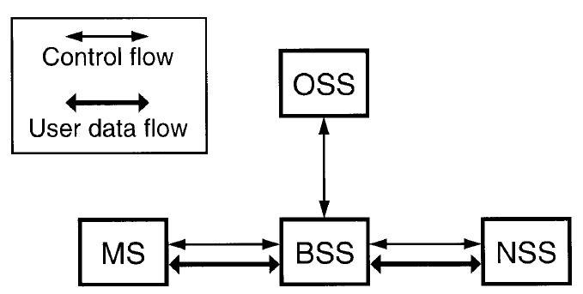
GLOBAL SYSTEM FOR MOBILE (GSM)

Slide 3
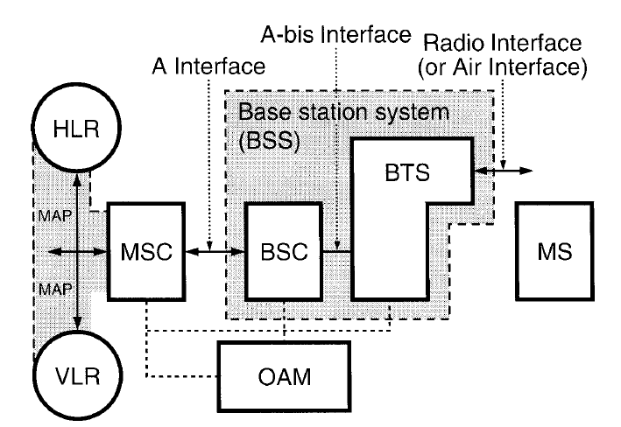
Functional architecture and principal interfaces.

Slide 4
NSS MANAGEMENT
Mobile Service Switching Center (MSC)
Interworking Function (IWF)
PSPDN(Packet switched public data network)
CSPDN(Circuit switched public data network)
Home Location Register(HLR)
Authentication Center (AUC)
Equipment Identity Register (EIR)
Visitor Location Register(VLR)
Gateway Msc (GMSC)
Signaling Transfer Point (STP)

Slide 5
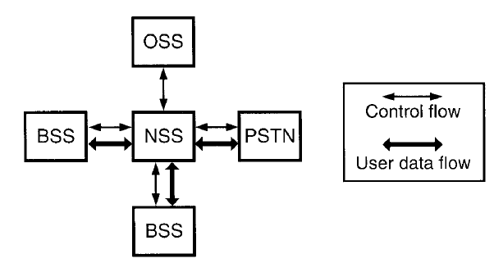
NSS and its environment. The external environment

Slide 6
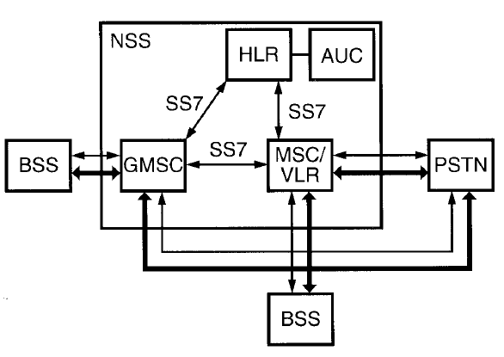
NSS and its environment The internal structure

Slide 7
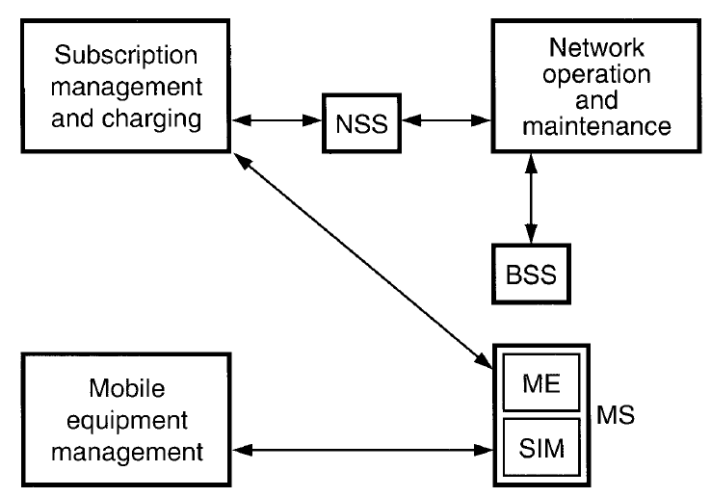
OSS organization

Slide 8
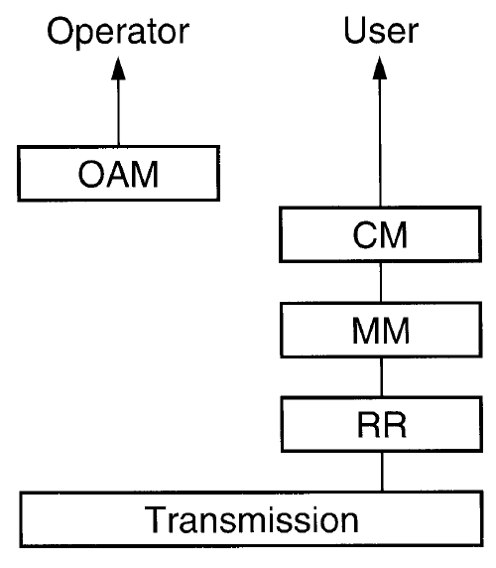
Layering Model (OSI MODEL) The functional planes of GSM

Slide 9
OPEN SYSTEM INTERCONNECTION MODEL
FIVE LAYERS
Transmission
Radio Resource Management (RR)
Mobility Management (MM)
Communication Management(CM)
Call Control
Supplementary Services Management
Short Message Service (SMS)
Mobile-originating short message
Mobile-terminating short message
Operation Administration & Management(OAM)

Slide 10
Transmission
Continuous Mode (Normal Mode)
Discontinuous transmission (DTX)
Voice Activity Device (VAD)
Silence Detection (SID) frame
Artificial noise or Comfort noise

Slide 11
Receiving Total Silence
The listener may believe that the transmission has been lost, and therefore hang up prematurely.
The speech may sound "choppy“ and difficult to understand.
The sudden change in sound level can be jarring to the listener.

Slide 12
Transmission Rates in Speech Coding
Toll quality (4<MOS<4.5)
Frequency range is 200 to 3200 Hz
Signal-to-Noise ratio >= 30 dB

Slide 13
Transmission Rates in Speech Coding
Commentary quality (MOS > 4.5)
Bit rates exceeding 64 kbps
Communications quality(3 < MMOS < 4)
Bit rates < 16 kbps
7.2 to 9.6 kbps

Slide 14
Transmission Rates in Speech Coding
Synthetic quality (2.5 < MOS < 3)
4.8 kbps and below

Slide 15
Data Service
Highest data rate is 9.6 kbps
Transparent (T) mode
Non-Transparent (NT) mode
Automatic Repeat Request (ARQ)
Interworking Function (IWF) at the network side
Terminal Adapting Function (TAF) at the terminal
Radio Link Protocol (RLP)

Slide 16
Stop-and-wait ARQ & Selective retransmission

Slide 17
Data transmission planes
End-to-end transmission—direct transmission through hard wire.
TAF to IWF transmission through subscriber units.
GSM radio transmission through subscriber units; acts like a voice call in the air.

Slide 18
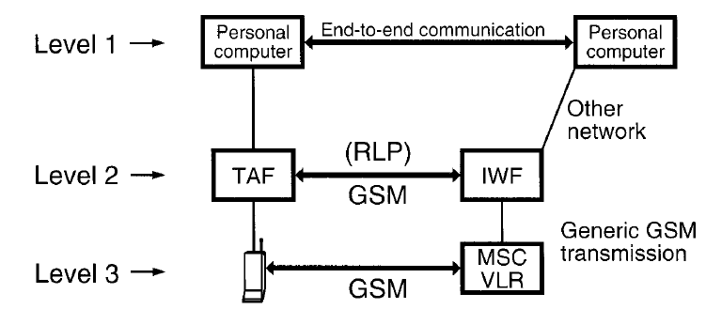
Data transmission planes

Slide 19
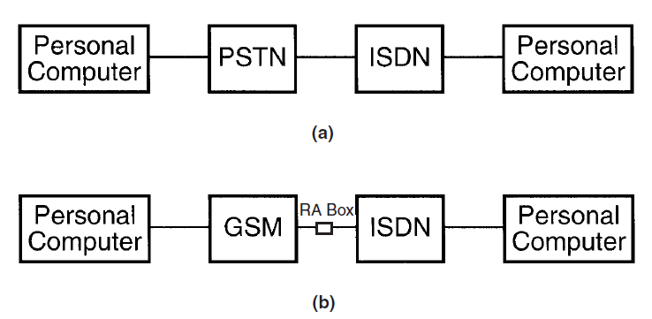
Interconnection with ISDN. (a) PSTN user to ISDN user (b) GSM user to ISDN user.

Slide 20
Radio Resource (RR) Management
Radio channel allocation
Three Management functions:
Location
Handover
Roaming

Slide 21
RR - Link Protocol
Signalling transfer information exchanges
Radio link protocol (RLP),
specified in GSM link access protocol over the radio link called LAPDm.
LAPD, the link access protocol (LAP) adapted from ISDN D channel.
Message transfer part (MTP), the protocols used for signaling transport on an SS7 network.

Slide 22
RR - Link Protocol
The Radio Link Protocol’s signaling message rate is 22.8 kbps
The signaling message rate on the other link protocol is 64 kbps

Slide 23
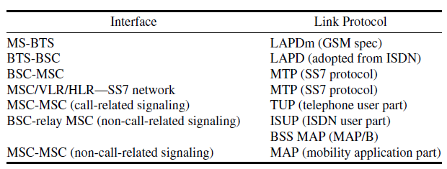
Interfaces Associated with Link Protocols

Slide 24
Non-call-related signals - Protocols
MAP/B Protocol between BSC and relay MSC
MAP/C Protocol between GMSC and an HLR
MAP/D Protocol between another MSC/VLR and HLR
MAP/E Protocol between MSCs

Slide 25
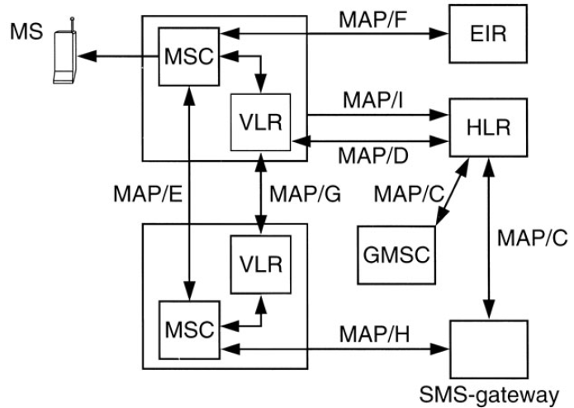

Slide 26
Mobility Management (MM)
Location updates
Handovers
Roaming

Slide 27
Location Update Management
Home Public Land Mobile Network (PLMN).
Visited PLMN
PLMN selection process
Automatic mode (the network searches)
Manual mode

Slide 28
Cell Selection
Choosing the best cell from an MS depends on three factors:
Level of the signal received by the mobile station
Maximum transmission power of the mobile station
Two parameters p1 and p2 specified by the cell. This is called the C1 criterion.

Slide 29
Cell Selection
p1 = a value between −110 and −48 dBm
p2 = a value between 13 and 43 dBm
Both values of p1 and p2 are broadcast from the cells.
B = p2 − maximum RF power of the MS
A = received level average − p1
C1 = A − max (B, 0)
MS maximum power = 29 to 43 dBm

Slide 30
Cell Selection Algorithm
A SIM must be inserted.
The strongest C1 is chosen by obtaining C1 from candidate cells; the C1 has to be higher
than 0.
All cells must not be barred from service.

Slide 31
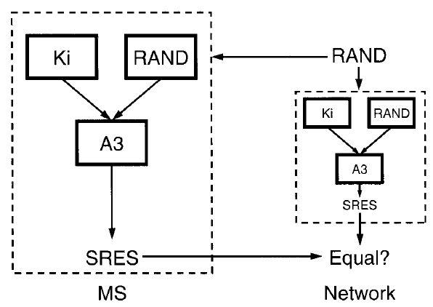
Authentication

Slide 32
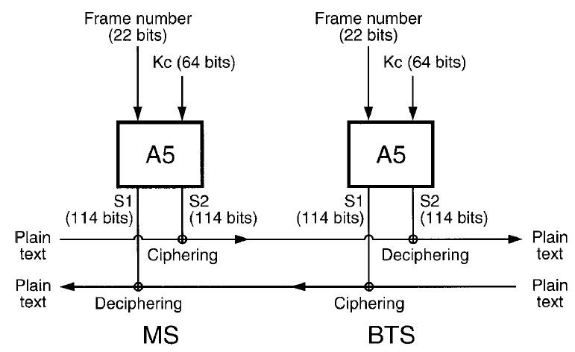
Encryption

Slide 33
User Identity Protection—Security Management
SIM (MS side) and AUC (network side)
Both sides perform A3 and A5 computations

Slide 34
Communication Management
Call Control
Supplementary Services Management
Short Message Service (SMS)
Mobile-originating short message
Mobile-terminating short message

Slide 35
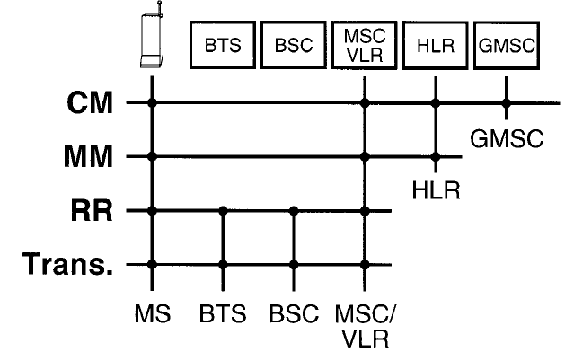
General Protocol Architecture of GSM

Slide 36
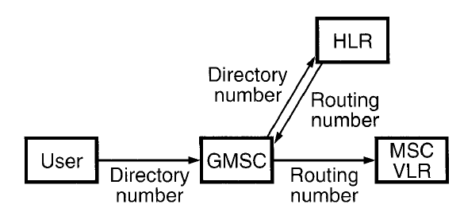
The key role of the GMSC for a domestic call

Slide 37
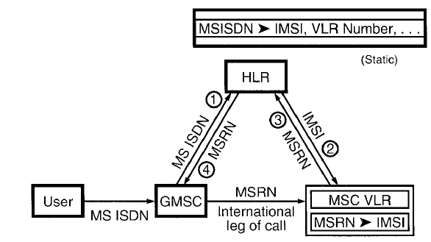
The provision of the MSRN for an international call

Slide 38
Network Management
Subscription Management
Billing & Accounting
Maintenance
Minimizing failures
Monitoring operations & improper operation situations
Subscriber Administration Tasks
IMEI – International Mobile Equipment Identity
15 digits
TAC – Type Approval Code – 6 digits
FAC - Final Assembly Code – 2 digits
Serial number which is stored in EIR – 6 digits
Spare digit or check digit– 1 digit

Slide 39
TAC – Type Approval Code
First 2 digits – country in which type approval was sought for the phone
Next 4 digits – approval number

Slide 40
FAC - Final Assembly Code
Identifies the place of manufacture or final assembly

Slide 41
Spare digit – Luhn Algorithm
IMEI is
490154203237518

