Slide 1
ANTENNAS AT CELL SITE
For Coverage
Use Omni-directional Antennas
High-Gain Antennas
There are standard 6-dB and 9-dB gain omni-directional antennas

Slide 2
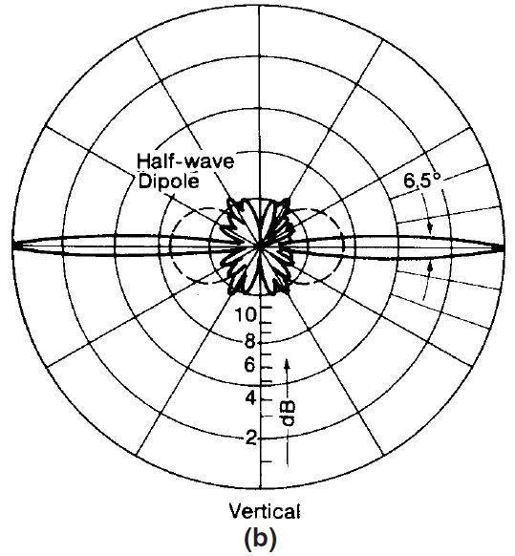
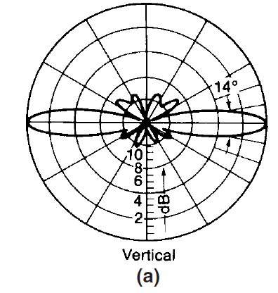
High-gain omnidirectional antennas Gain with reference to dipole: (a) 6 dB; (b) 9 dB

Slide 3
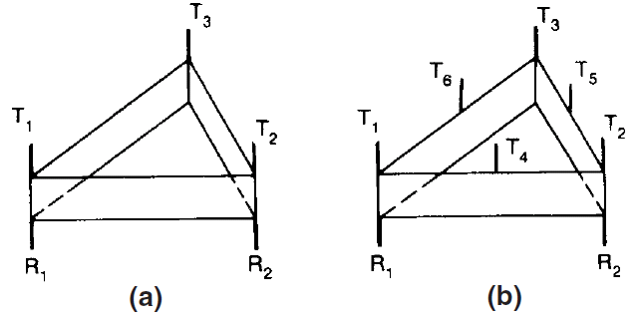
Cell-site antennas for omnicells
(a) for 3N channels (b) for 6N channels.

Slide 4
Ring combiner
A ring combiner is used to combine two groups of channels into a single output.
The function of a ring combiner is to combine two 16-channel combiners into one 32-channel output.
Therefore, all 32 channels can be used by a single transmitting antenna.
The ring combiner has a limitation of handling power up to 600 W with a loss of 3 dB.

Slide 5
Relation between Gain and Beam Width
Relation between Gain and Beam Width
The receiver gain G_{R} can be related to its half-power beam width as
θ_{HP} and φ_{HP} are the half-power beam widths in the θ and φ planes
The factor 4π is the solid angle subtended by a sphere in steradians (square radians)

Slide 6
Relation between Gain and Beam Width

Slide 7
A typical pattern for a directional antenna of 120° beamwidth
(a) Azimuthal pattern of 8-dB directional antenna

Slide 8
A typical pattern for a directional antenna of 120° beamwidth
(b) Vertical pattern of 8-dB
directional antenna

Slide 9
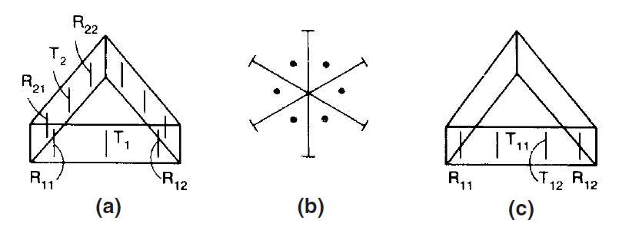
Directional antenna arrangement
(a) 120◦ sector (45 radios);
(b) 60◦ sector;
(c) 120◦ sector (90 radios).

Slide 10
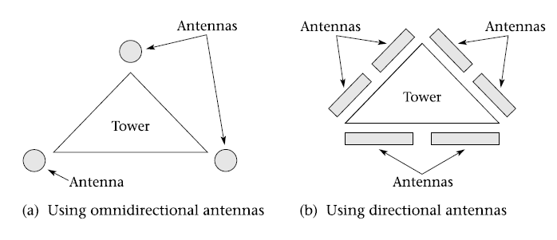
Cell-site antenna mounting

Slide 11
Other Antennas at cellsite
Location antennas
Setup channel antennas
Spaced diversity antennas

Slide 12
Spatial Diversity

Slide 13
Diversity Antenna Spacing
η = h/d;
(b) proper arrangement with two antennas.

Slide 14
Umbrella-Pattern Antennas
Normal Umbrella-Pattern Antenna.
Broadband Umbrella-Pattern Antenna
High-Gain Broadband Umbrella-Pattern Antenna

Slide 15
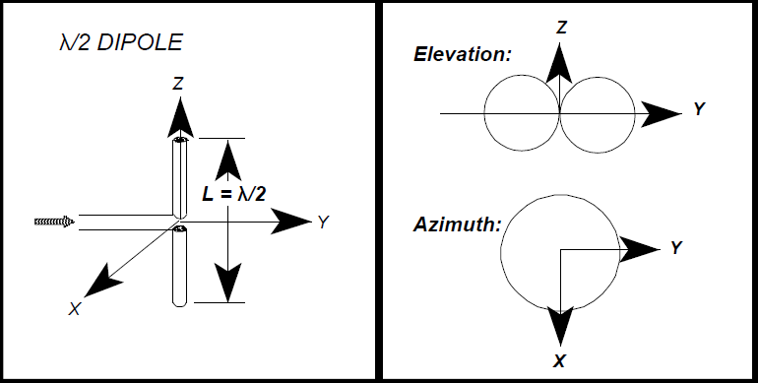
Dipole antenna

Slide 16
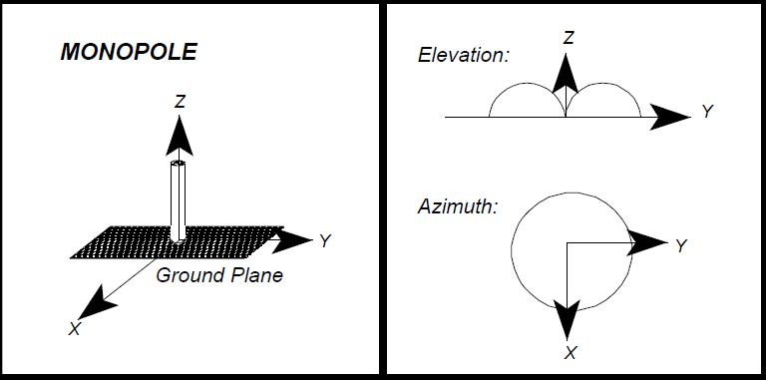
Monopole Antenna

Slide 17
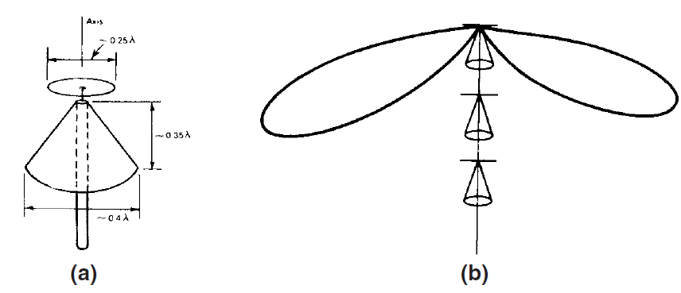
Discone Antennas
Single antenna.
An array of antennas

Slide 18
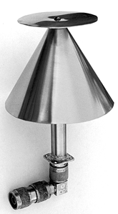
Photo of discone antenna

Slide 19
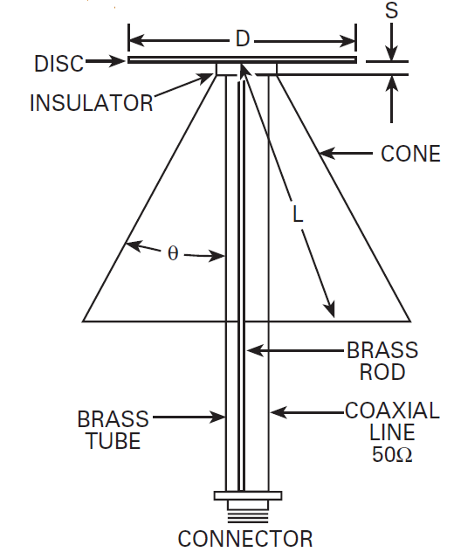
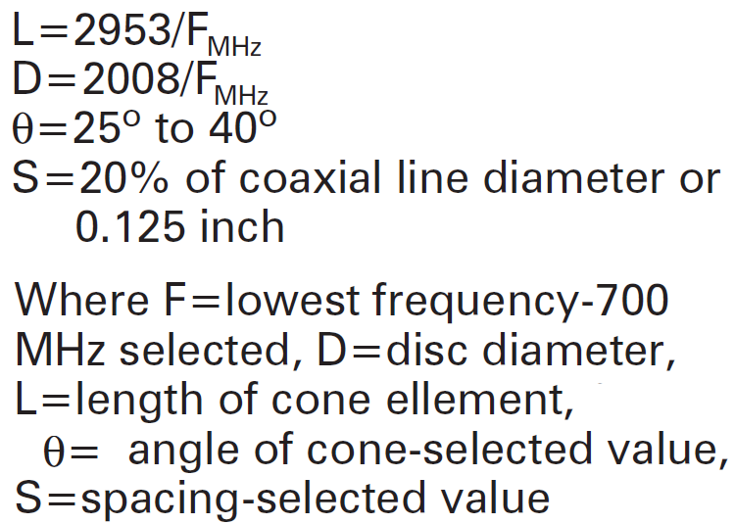
Discone Antenna

Slide 20
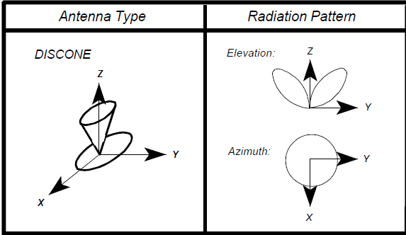
Radiation pattern

Slide 21
High gain Broadband umbrella-pattern antenna

Slide 22
UNIQUE SITUATIONS OF CELL-SITE ANTENNAS
Antenna Pattern in Free Space and in Mobile Environments

Slide 23
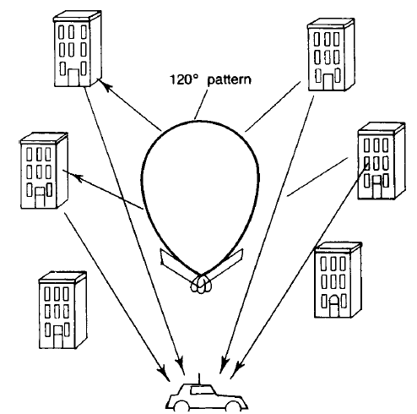
Front-to-back ratio of a directional antenna in a mobile radio environment.

Slide 24
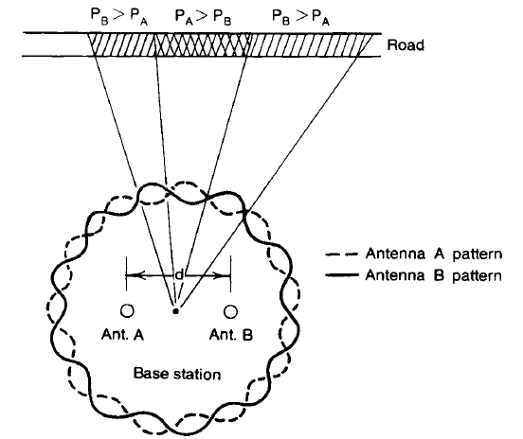
Minimum Separation of Cell-Site Receiving Antennas
Antenna pattern ripple effect

Slide 25
Regular Check of the Cell-Site Antennas
Choosing an Antenna Site

Slide 26
MOBILE ANTENNAS
Roof-Mounted Antenna
Glass-Mounted Antennas

Slide 27
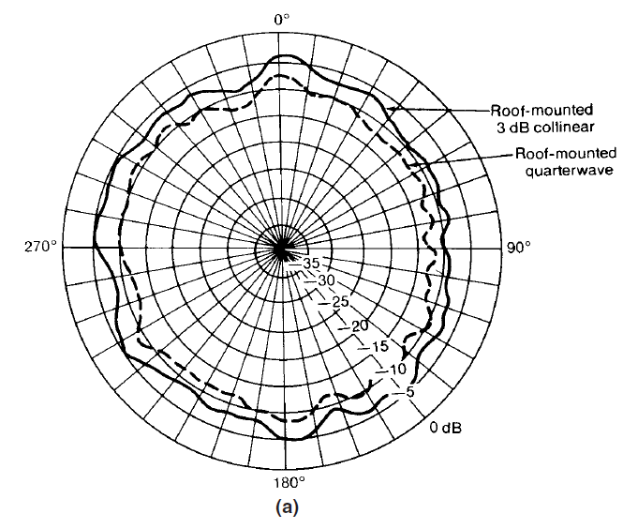
Mobile antenna patterns
(a) Roofmounted
3-dB-gain collinear antenna versus roof-mounted quarter-wave antenna.

Slide 28
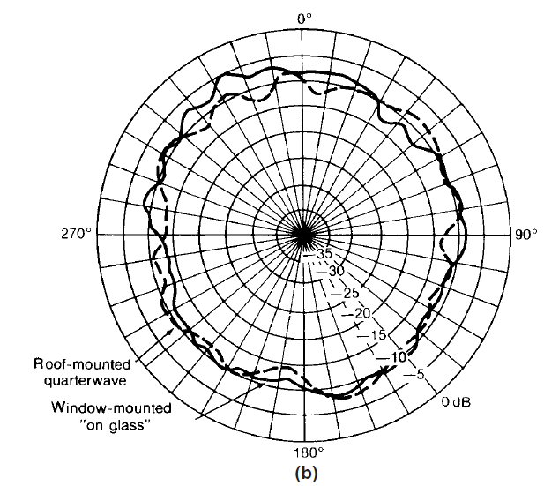
Mobile antenna patterns
(b) Windowmounted
“on-glass” gain antenna versus roof-mounted quarter-wave antenna.

Slide 29
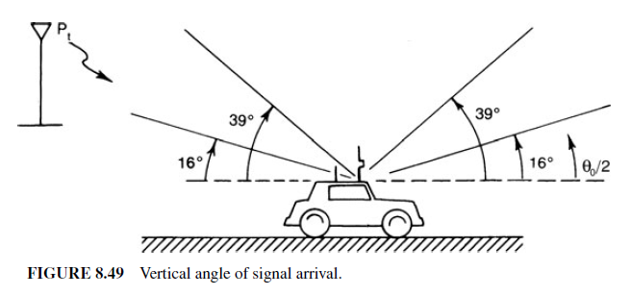
Roof Mounted Antenna

Slide 30
Mobile Antennas
Mobile High-Gain Antennas
Horizontally Oriented Space-Diversity Antennas
Vertically Oriented Space-Diversity Antennas

Slide 31
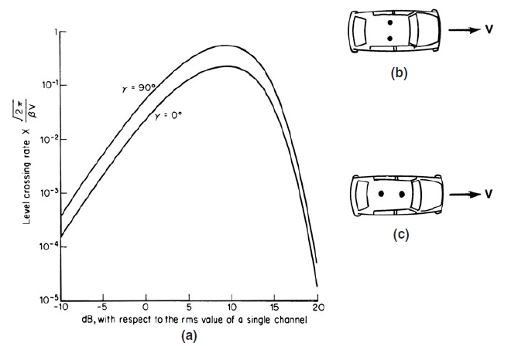
Horizontally spaced antennas
(a) Maximum difference in lcr of a four-branch equal-gain signal between α = 0 and α = 90◦ with antenna spacing of 0.15λ
(b) Not recommended. (c) Recommended.

Slide 32
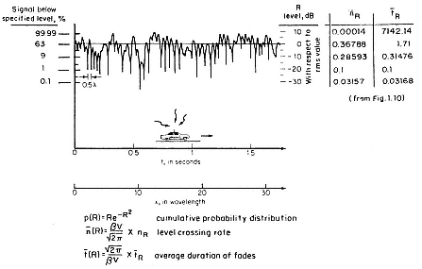
Level Crossing Rate

Slide 33
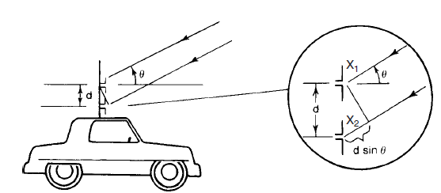
Vertical separation between two mobile antennas.

Slide 34
The theoretical derivation of correlation

Slide 35
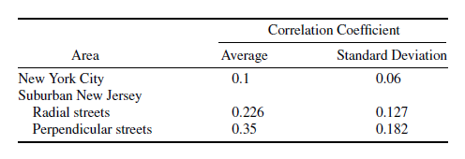
Correlation coefficients in different areas and different street orientations.

Slide 36
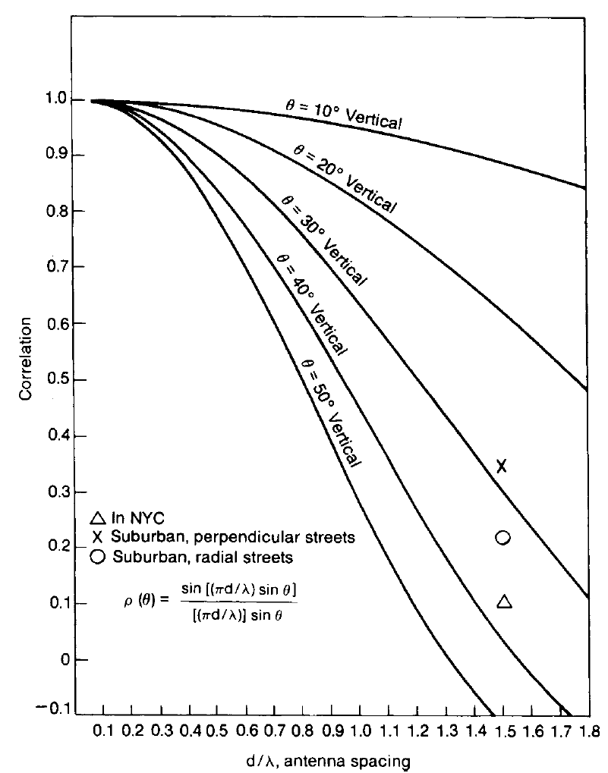
Two vertically spaced antennas mounted on a mobile unit.

