Slide 1
Unit – 6
Frequency Management and Channel Assignment

Slide 2
Frequency Management
Frequency management
Designating set-up channels and voice channels (done by the FCC),
Numbering the channels
(done by the FCC), and
Grouping the voice channels into subsets
(done by each system according to its preference).

Slide 3
Channel assignment
Means the allocation of specific channels to cell sites and mobile units.
A fixed channel set – Cellsite- long-term basis
During a call- Mobile unit - short-term basis (handled by MTSO).

Slide 4
Channel Assignment
Ideally channel assignment should be based on causing the least interference in the system.

Slide 5
Numbering the Channels
The total number of channels (January 1988) is 832.
But most mobile units and systems are still operating on 666 channels.
A channel consists of two frequency channel bandwidths,
one in the low band
one in the high band

Slide 6
Numbering the Channels
Two frequencies in channel 1 are
825.030 MHz (mobile transmit) and
870.030 MHz (cell-site transmit)
The two frequencies in channel 666 are
844.98 MHz (mobile transmit) and
889.98 MHz (cell-site transmit)

Slide 7
Numbering the Channels
The 666 channels are divided into two groups:
block A system
block B system

Slide 8
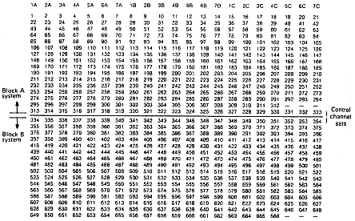
Frequency-management chart.

Slide 9
Numbering the Channels
Each block has 333 channels
The 42 set-up channels are assigned as follows.
Channels 313 - 333 block A
Channels 334 - 354 block B
The voice channels are assigned as follows.
Channels 1 - 312 (312 voice channels) block A
Channels 355 - 666 (312 voice channels) block B

Slide 10
Numbering the Channels- additional spectrum allocation
New additional spectrum allocation - 10 MHz -additional 166 channels are assigned
a 1 MHz is assigned below 825 MHz (or 870 MHz)
additional channels will be numbered up to 849 MHz (or 894 MHz) and will then circle back
The last channel number is 1023 (=2¹⁰)
There are no channels between channels 799 and 991.

Slide 11
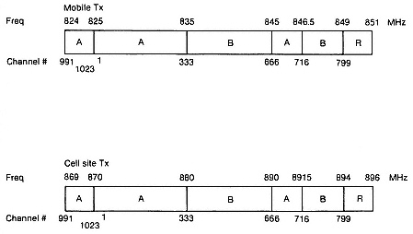
New additional spectrum allocation

Slide 12
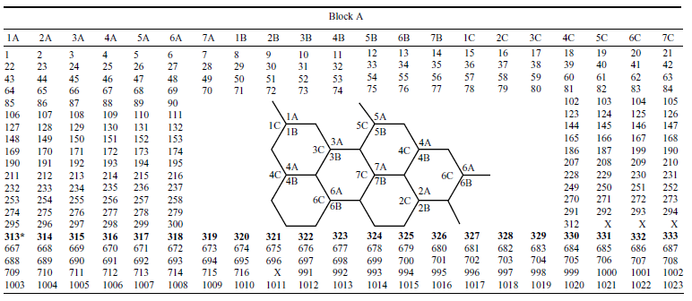
Full Spectrum Frequency Management

Slide 13
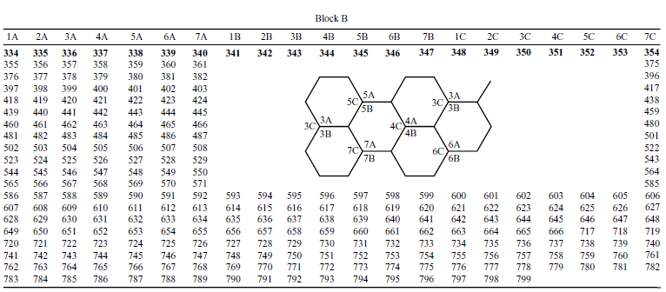
Full Spectrum Frequency Management

Slide 14
Grouping into Subsets
Voice channels for each system is 312
We can group these into any number of subsets
21 set-up channels for each system
it is logical to group the 312 channels into 21 subsets
Each subset then consists of 16 channels
In each set, the closest adjacent channel is 21 channels away

Slide 15
Grouping into Subsets
The 16 channels in each subset - connected to a channel combiner
Wide separation between adjacent channels -requirement of minimum isolation
Each 16-channel subset is idealized for each 16-channel combiner

Slide 16
Grouping into Subsets
In a seven-cell pattern system each cell contains three subsets,
iA + iB + iC
where i is an integer from 1 to 7
The total number of voice channels in a cell is about 45
The minimum separation between three subsets is 7 channels (21/3)

Slide 17
Grouping into Subsets
If six subsets are equipped in an omnicell site,
Minimum separation between two adjacent channels can be only three (21/6 > 3) physical channel bandwidths
For Example

Slide 18
Techniques for increasing frequency spectrum
Increasing the number of radio channels using narrow banding, spread spectrum, or time division
Improving spatial frequency-spectrum reuse
Frequency management and channel assignment
Reducing the load of invalid calls
Voice storage service for No-Answer calls
Call forwarding
Call waiting for Busy-Call situations
Queuing

Slide 19
Set-up Channels
Set-up channels, also called control channels,
Channels designated to set up calls
A system can be operated without set-up channels
Set-up channels can be classified by usage into two types
access channels
paging channels

Slide 20
Access channels - Operational functions
Power of a forward set-up channel [or forward control channel (FOCC)]
The set-up channel received level (Threshold)-RECC
Change power at the mobile unit(Messages)
Mobile station control message
System parameter overhead message
Control-filler message
Direct call - retry

Slide 21
Mobile station control message
DCC – Digital Color Code
A Digital Signal transmitted by an FOCC to detect capture of an interfering mobile station
Mobile station uses DCC to identify the land station
MIN
VMAX
SCC

Slide 22
SCC – SAT Color Code

Slide 23
System parameter overhead message
DCC
SID - A digital identification uniquely associated with a cellular system(15-bit)
CMAX
CPA - Combined paging/access
CPA = 1 Paging &access channel are the same
CPA = 0 Paging &access channel are not the same

Slide 24
Control-filler message
CMAC - a control mobile attenuation code
the mobile station has to adjust its transmitter power level before accessing a system on a RECC

Slide 25
Paging Channels
The assigned forward set-up channel (FOCC) of each cell site is used to page the mobile unit with the same mobile station control message

Slide 26
Selecting a voice channel
For mobile-originating calls
For paging calls

Slide 27
Channel Assignment to the Cell Sites-Fixed Channel Assignment
Set-up channels & Voice channels
long-term basis

Slide 28
Fixed Channel Assignment
Setup-channels
21 channels
N = 4, 7, 12 cell reuse patterns
Omni-directional antennas
One channel per cell
Unused set-up channels
Avoid interference between block A and B

Slide 29
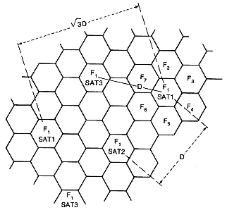
Fixed Channel Assignment
Voice Channels
21 subsets
Min. cochannel & Adjacent channel interference
3 SAT Tones

Slide 30
Channel Assignment to Travelling Mobile Units
Underlay-overlay
Frequency Assignment
Tilted Antenna

Slide 31
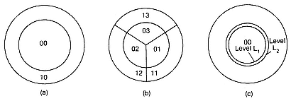
Channel Assignment to Travelling Mobile Units
Underlaid-overlaid cell arrangements
(a) Undelay-overlay in omnicell (b) underlay-overlay in sectorized cells
(c) two-level handoff scheme

Slide 32
Underlay-overlay arrangement

Slide 33
Fixed Channel Assignment
Adjacent-Channel Assignment
Channel Sharing and Borrowing
Sectorization

Slide 34
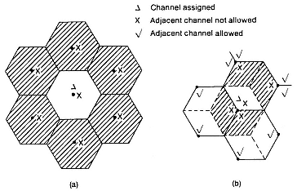
Adjacent-Channel Assignment
Adjacent channel assignment.
(a) Omnidirectional-antenna cells (b) directional-antenna cells

Slide 35
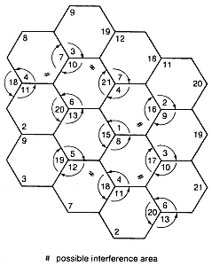
Channel Sharing and Borrowing
Channel Sharing
Algorithm

Slide 36
Sectorization
The 120º sector cell for both transmitting and receiving
The 60º sector sell for both transmitting and receiving
120º or 60º sector cell for receiving sectorization only , and transmitting antenna is omni-directional

Slide 37
Non-Fixed Channel Assignment algorithms
Dynamic Channel Assignment
Hybrid channel Assignment
Borrowing channel Assignment
Forcible-borrowing channel Assignment

Slide 38
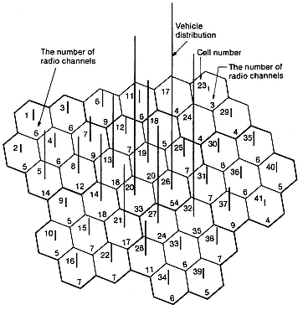
Simulation process and results
Cellular system.
Vehicle and radio-channel distribution in the busy rush hour

Slide 39
Simulation process and results
Average Blocking
Handoff Blocking

